Slide 1
Guide to CINDERS (Cockpit Integrated Network Deployed Extinguisher Response System)
Codey Sivley
Radiance Technologies
Last Update:
June 2022

Slide 2
Acronyms and Terminology
CINDERS = Cockpit Integrated Network Deployed Extinguisher Response System
HEL = High Energy Laser
HELSTF = High Energy Laser System Test Facility
WSMR = White Sands Missile Range
DAQ = Data Acquisition
HAZMAT = Hazardous Materials
LAN = Local Area Network
GPIO = General Purpose Input/Output

Slide 3
Index
User Guide
Introduction
Potential Dangers
Hardware installation and setup
Setting up CINDERS
Pressure Regulator Installation
Solenoid Installation
Power Up
Remote Login
Software
Documentation
CINDERS Design Philosophy
Failure Logs
Backups

Slide 4
User Guide

Slide 5
Introduction
Welcome to CINDERS.
CINDERS is custom fire extinguisher system developed to support lethality testing at HELSTF. It consists of a clean extinguishing agent, pressure regulators, solenoids, and an electrical control box.
There are various inherent dangers in using CINDERS. Please read this guide to ensure safe operation.
Death or severe injury can occur to users who are not aware of the risks!

Slide 6
Potential Dangers
Clean Agent Tanks
Tanks are under high pressure.
Wear safety glasses and other appropriate PPG when installing pressure regulators and other hardware.
CO2 in tanks can kill if inhaled at high concentration.
Ensure test area is properly ventilated during setup.
Ensure fittings are tight and are not leaking CO2 into test area.
Close tank when not in use to prevent leaking.
Properly ventilate cockpit/enclosure after shots to prevent inhalation of CO2 or burnt particulates.
Electrical
Solenoids are powered by 120v mains power.
Ensure relay box is disconnected from power before adjusting connections.
Fire
CINDERS is used to extinguish fires.
Use proper precautions and safety for dealing with fire.

Slide 7
Setting Up CINDERS
Basic installation of CINDERS
Installation of Pressure Regulators and Solenoids
Connection of Solenoids to Control Box
Power Up System
Pressurize
Remote Login

Slide 8
Pressure Regulator Installation
The pressure regulators are a high-flow model that resists freezing during extended deployments.
Installation:
Ensure the CO2 tank is closed.
Attach regulator to CO2 tank outlet (CGA 320 valve)
Ensure pressure regulator is closed. (Turn clockwise to tighten)
Open CO2 tank. Note that top dial on pressure regulator displays pressure.
Open pressure regulator until bottom dial reads 90PSI.
Repeat for each CO2 tank to be employed.
IMPORTANT: Ensure CO2 tank is closed before powering on CINDERS. The Raspberry Pi activates the GPIO pins during bootup, which will momentarily trigger the solenoids if they are connected. This can lead to unexpected release of high pressure CO2 from the outlet.
Specs
Vendor: Preece Precision
Model Num: 3000-250A-320-QC
CGA320 Tank Connection, Dual Gauges, Quick Connect Outlet, 0-250PSI

Slide 9
Solenoid Installation
The solenoids are Omega SV3311 with upgraded AC coils to enable operation up to 100PSI.
Installation:
Ensure Control Box is disconnected from power.
Ensure CO2 tank is closed.
Connect solenoid male NPT to pressure regulator quick-connect.
Connect air hose from solenoid female quick-connect to test enclosure.
Connect color-coded power connectors from solenoid to cable from Control Box.
Connect Control Box to power.
Specs
Vendor: Omega
Model: SV3311, SV12COIL-120/60HZ
Up to 100PSI
Male 1/4NPT quick-connect installed on inlet.
Female 1/4NPT quick-connect installed on outlet.

Slide 10
Power Up
Once CINDERS hardware is installed, ensure tanks are closed by turning valve knob clockwise until tightened.
Power on CINDERS Controller by connecting to power.
It is best to connect the Controller to power first, because the GPIO booting sequence could cause unexpected release of clean agent.
Power on CINDERS Relay Box by connecting to power.
Connect to CINDERS Controller via VNC or PuTTY

Slide 11
Remote Login
CINDERS Control Box contains a Raspberry Pi which allows remote access control of the solenoids. The Raspberry Pi runs a version of Linux, and therefore does not allow remote access via Windows Remote Desktop Connection. Connection is via VNC viewer.
VNC Login:
Username: pi
Password: ssltsslt
IP address: 192.168.100.232
If VNC Login is unavailable, CINDERS will allow terminal access via PuTTY. In the home directory, the cindersCLI.py file will allow command line control of the system.
PuTTY Login:
IP address: 192.168.100.232
Username: pi
Password: ssltsslt

Slide 12
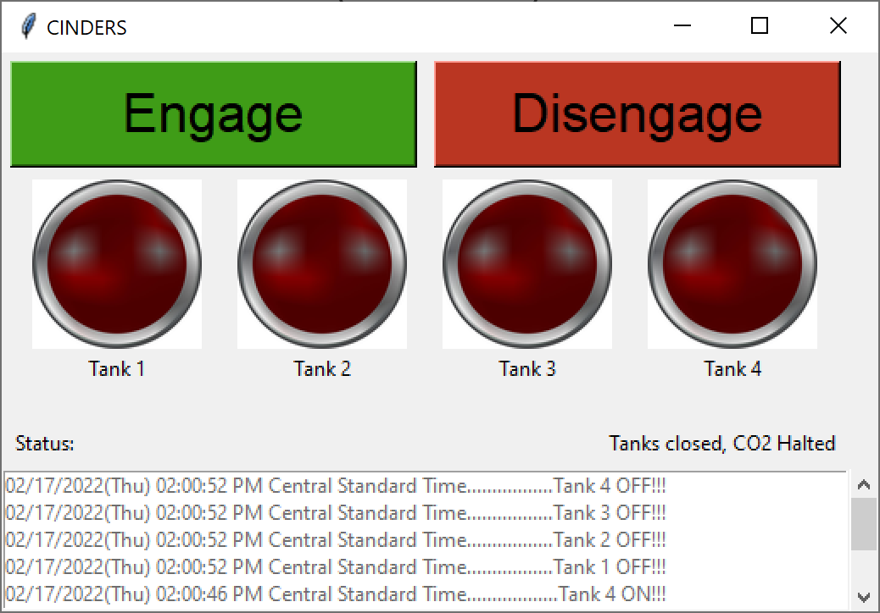
CINDERS Software
Current features v1.7 (as of 2/23/2022):
Engage/Disengage buttons.
Logging of system use with timestamps.
Remote login via PuTTY or VNC.
Staggered triggering of solenoids to prevent amp spikes.
On screen tank activity display (red lights)
Features in progress:
Rebuilding in OOP style to enable more modular selection of tanks

Slide 13
CINDERS Voltage Map
Solenoid Opens
Solenoid AC Coil
Relay
RasPi
I/O Interface
120V AC Power
High Pin signal
Operator Control
5v Control Voltage
120V AC
Power
12v DC
Power
120v
AC
RasPi PSU

Slide 14
Documentation

Slide 15
Test Cycle
Target In Place
DAQ Armed
Personnel Safe
Fire Suppr. Armed
Ready to Fire HEL
Fire Sequence, ETA 1-3 minutes
Fire On Target
Deploy Fire Suppression
Fire Extinguished
Test Site Safe
No personnel on site
Setup Sequence, ETA 45 minutes
Fire Suppression & Target personnel on site
Fire Suppression Reload
New Target Setup
Camera and Sensor Data Processing

Slide 16
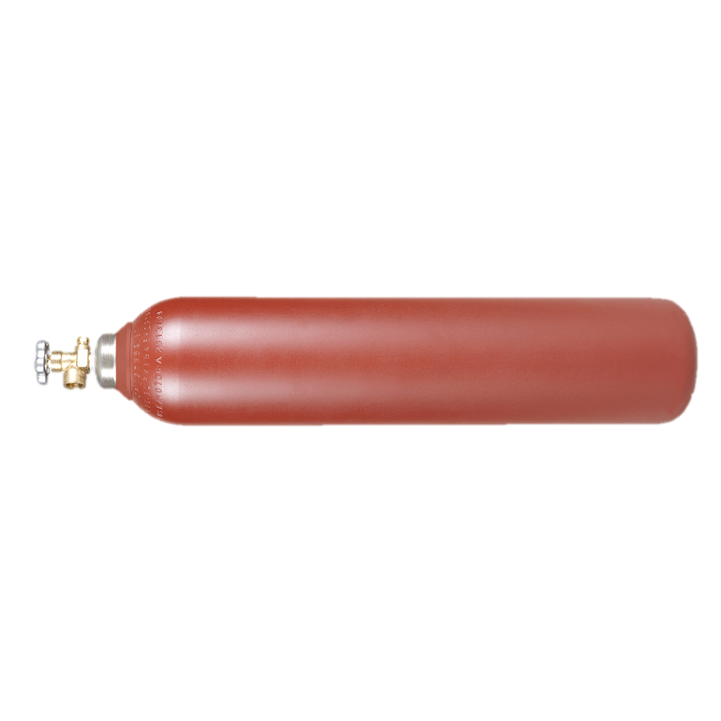
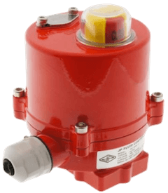
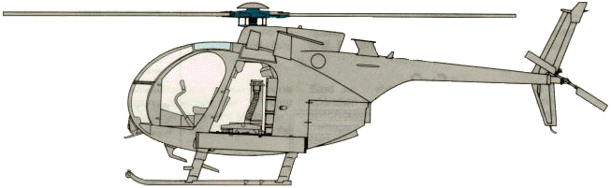

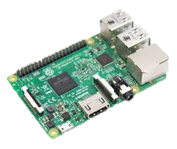
System concept
Electrically controlled Solenoid
Clean Agent delivery hose to cockpit
Replaceable Clean Agent
source tank
Actuator control via GPIO
Remote GPIO control
via Ethernet
Fire suppression via displacement of O2 from “fire triangle”
GPIO Microcontroller

Slide 17
Fire Suppression Flowchart
START
Is fire contained and safe to burn itself out?
Is fire small enough to be managed by On-Site personnel?
Target and/or Test Site on fire
No
No
Deploy remote fire suppression
Yes
Yes
Call HELSTF Fire Department
Wait for fuel to be depleted
On-Site Fire Safety Officer with handheld extinguisher
Fire extinguished?
No
Fire dead, prepare next shot
Yes

Slide 18
Post-shot Safety
CO2 is hazardous to humans in concentrations greater than 17%.
At least 34% CO2 required to smother fire. (Industry Standard via Koorsen)
Effects @ concentration >17% include loss of controlled and purposeful activity, unconsciousness, convulsions, coma, and death within 1 minute of inhalation.
Test chamber must be vented of CO2 before personnel set up the next shot
Locally-controlled ventilation system will be installed on Cockpit
Include a CO2 sensor inside cockpit to indicate if CO2 is at dangerous levels
Selected sensor has audio and visual alerts indicating dangerous levels
Possible Ventilation methods
Powered fan system
Door opening
Alternatively, using Halotron is much safer, and is unlikely to cause major side effects unless intentionally abused. Far more expensive.
System is capable of converting to Halotron with minimal adjustment.

Slide 19
CINDERS Failure Log

Slide 20
CINDERS Failure Log: AVL-12
During the operation of CINDERS, some fires fail to be extinguished. The following slides describe the failure, a diagnosis of the problem, the method taken to correct the failure, considerations moving forward, and possible enhancements to the system.
AVL-12 Mannequin Testing:
Failure: During test setup, CINDERS failed to increase the CO2 concentration to a point that would smother a fire.
Diagnosis: The test cell was not properly enclosed. For CINDERS to increase CO2 to the appropriate level, the test cell should only allow venting at the top, due to the fact that the CO2 is heavier than air, and will therefore fill the container from the bottom. If the fire is above a large hole in the test cell, the system will fail to extinguish.
Method Taken: In order to accommodate the open test cell, the injection port was fitted with an aluminum hose that directs the CO2 directly to the point of fire. Note that the method of extinguishing is no longer smothering the fire via oxygen displacement, but forcefully blowing out the fire.
Considerations: If the system is being operated in a non-closed test cell, the stream of clean agent must be directed towards the site of the flames.
Enhancements: None at this time, due to reliance on test setup. A remote-control servo system to allow operator adjustment of the nozzle would be nice, but would also introduce a new layer of complexity.

Slide 21
CINDERS Failure Log: AVL-12
Failure: Following a shot, CINDERS failed to blow out a flame upon a white cotton t-shirt.
Diagnosis: The hose between the solenoid and the injection port had been knocked loose by test conductors during changing of targets. The solenoid triggered, but because the port was not connected, no CO2 flowed into the cockpit. Fortunately, the hoses used do not allow a fluid to pass through without a connection as a safety feature. This prevented the hose from flailing wildly during the solenoid trigger.
Method Taken: The hose was reconnected, and the system operated properly afterwards.
Considerations: A short test of the system before each shot is ideal. However, some target setups may not allow this while the target is installed. It is up to the test conductor to consider this during the shot setup sequence.
Enhancements: A plan to install manual test buttons onto the hardware that allow testing of the solenoids without software is planned. Until then, pre-test connections will need to be performed via the touchscreen.

Slide 22
CINDERS Failure Log: AVL-12
Failure: Following a shot, CINDERS failed to blow out a flame upon a white cotton t-shirt.
Diagnosis: The injection port hose was directed towards the point of flame. However, the diameter of the hose is less than half an inch. The flame had spread to approximately 6-8 inches in diameter. When triggered, the system successfully blew out the flame at the location the injection hose was aimed at. However, the hose did not reach flame beyond this area.
Method Taken: None yet, as the event was near the end of the test series.
Considerations: The flame must be extinguished early if a narrow hose is used. Test conductors should plan to create a custom manifold for the injection port to direct the clean agent over a larger area if required, but be wary the pressure capabilities of the system have an upper bound to the scale it can support. Too many nozzles will simple disperse the same amount of air over a large area at velocities insufficient to blow out a flame.
Enhancements: Again, a servo aiming system would be nice, but would likely introduce complications and breakdowns. A small array of readymade nozzles would increase the flexibility of the system.

Slide 23
Test Design Considerations
Goal: Dispense 12.8 lbs of CO2 into Cockpit. Assume 15lbs required for margin-of-error.
Option 1: “Disposable” smaller tanks
Use four 5lb COTS carbon-dioxide fire extinguishers. When deployed, empty tanks entirely.
Pros:
No guesswork of how much CO2 is left before shot.
Ease of handling, smaller tanks.
No need to refill.
Minimize pre-test setup.
Cons:
Approximately $800/shot. Four CO2 fire extinguishers @ approx. $175/ each. ($40/lb CO2)
Empty tanks will need to be disposed / recycled.
Set-up time between each shot.
Option 2: Refillable smaller tanks
Use four 5lb-10lb industrial grade carbon dioxide tanks. When deployed, empty tanks entirely.
Pros:
Cheaper total cost, approx.
$100/tank (not including pressure regulators)
Approx $58 for 50lb industrial grade CO2 tank. ($1.10/lb CO2)
Refill smaller tanks on-site as needed.
Cons:
Moderate pre-test setup.
More labor required: refilling tanks, refilling source CO2 tank
Set-up time between each shot to exchange tanks

Slide 24
Test Design Considerations
Option 3: Refillable larger tanks
Use four 20-50lb tanks. When deployed, use only until fire is extinguished.
Pros:
Most cost-efficient option.
Less per-shot setup time: tanks would only need to be changed once every few shots.
Tank has time to temperature-equalize between shots, reducing likelihood of freezing vs full dump.
Cons:
Most complicated pre-test setup.
Requires management/monitoring of remaining CO2 in tanks.
Monitor via delta-T
Measure time for tank to run dry pre-test, establish capacity.
Monitor time tank is deployed during each shot.
Subtract time deployed from capacity available per-tank to calculate remaining CO2.
Monitor via mass-flow
Measure mass flow of tanks as deployed, subtract from mass total.
Monitor via weight
Each tank is on a scale, tare to empty tank weight.
As tanks deployed, remaining weight of CO2 available.
Risk of “running-dry” during shot if not tracked accurately.
Larger tanks may require two-man-lift to transport and exchange.

Slide 25
Test Design Considerations
Option 4: Hybrid of previous methods
Use COTS CO2 Extinguishers or small refillable tanks in tandem with larger tanks.
E.G.: Three 5lb tanks, One 50lb tank
Pros:
Use of smaller tanks means reliable dump of CO2 without risk of running dry from large-tank miscalculation.
Supplementing smaller tanks with larger tanks reduces small-tank cost significantly.
Large tank provides “follow through” in case smaller tanks weaken fire but fail to totally extinguish.

Slide 26
Calculation of Time to Smother via Oxygen Starvation
Number of Solenoids | Time (AC coil, 90psi) | Time (DC coil, 60psi)
1 valve | 1.97 mins | 2.97 mins
2 valve | 0.99 mins | 1.49 mins
3 valves | 0.66 mins | 0.99 mins
4 valves | 0.48 mins | 0.74 mins
Given:
Temperature = 60F
Gas = C02
Inlet Pressure = 90PSI
Outlet Pressure = 1bar
Specific Gravity = 1.529
CV (of valve) = 0.63
Worst-Case Volume = 125 cft (Calculated Volume 121ft^3, not including pilot and instrumentation)
Our flow rate for each valve will be 21.47 standard cubic feet per minute (SCFM) with the AC coil.
Currently the flow rate for each valve is 14.31 SCFM with the DC coil.
Our time to fill a volume to a given percentage, can be represented as a formula: T = P*V/SCFM
Where T = Time in minutes, P = desired percentage, V = Volume in cubic feet
Assuming 100% conservation of CO2 (only normal air is displaced from the volume).
Industry standard for smothering a fire with CO2 is 34% concentration (per Koorsen)
These simplified calculations do not consider changes in inlet pressure, but the equation is linear by pressure change.
Pressure change should be logarithmic, with pressure only dropping as the tank is nearly empty.
Sources:
Solenoid datasheet: https://assets.omega.com/pdf/valves/solenoid-valves/SV3300.pdf
Flow calculator: https://www.teesing.com/en/page/library/tools/flow-and-cv-calculator
Critical flow equations: http://www.idealvalve.com/pdf/Flow-Calculation-for-Gases.pdf
Engineering toolbox for specific gravity: https://www.engineeringtoolbox.com/density-specific-weight-gravity-d_290.html

Slide 27
Backups

Slide 28
CINDERS Control To Do:
Add individually addressable solenoid arming and disarming
Flexible GUI to adjust Tank Display lamps?
Red-Yellow-Green -> Disarmed, Armed, Deploying
Add pulse button for testing airflow
Add series/shot name text entry box for data logging
Animated icon to indicate connectivity
Setup/Test tabs?
Setup Tab
Test pulse
Arm/disarm
Test Tab
Deploy Armed Tanks
Hardware
Add pressure sensor to confirm flow?

Slide 29
CINDERS Documentation To Do:
Add wiring diagram
Add photographs of components to hardware section

